Slide 1
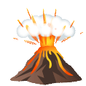


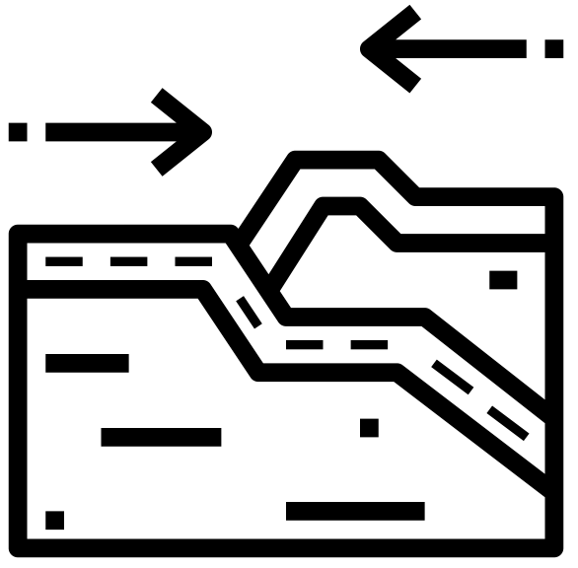




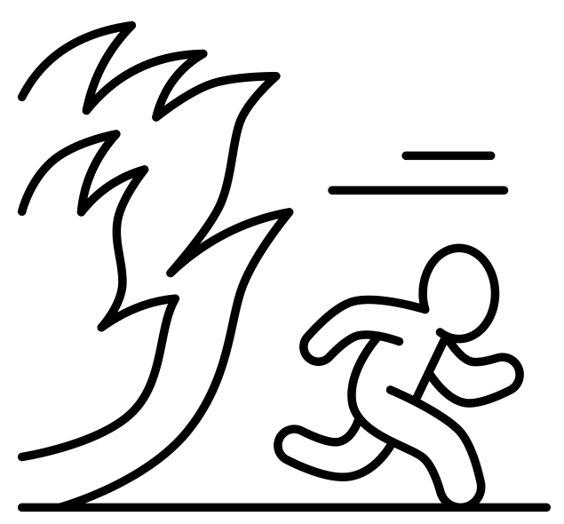


Title: How do we measure the impact of Earthquakes?
LO: Explain how earthquakes occur; Compare and contrast different measurement scales of seismic activity
Date: Thursday 6th November 2025
Title: How do we measure the impact of Earthquakes?
How is each icon is linked to what we have studied about tectonic hazards
A
B
C
D
E
F
G
H
I

Slide 2
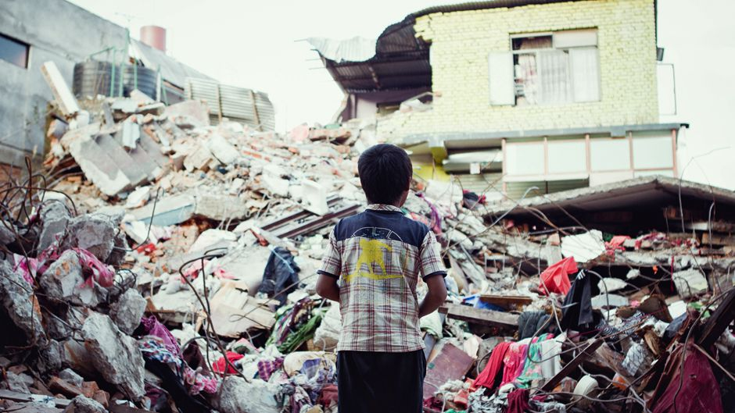
Title: How do we measure the impact of Earthquakes?
LO: Explain how earthquakes occur; Compare and contrast different measurement scales of seismic activity
T – Truth What do you notice in the picture?
H – Human What features of human geography can you spot in the picture?
I – Investigate What questions could you ask to find out more about this picture?
N – Nature What features of physical geography can you see in the picture?
K – Knowledge How do earthquakes happen?
THINK like a Geographer:

Slide 3




Title: How do we measure the impact of Earthquakes?
LO: Explain how earthquakes occur; Compare and contrast different measurement scales of seismic activity
Keywords:
Earthquake |  | A sudden shaking of the Earth’s surface caused by movement of tectonic plates beneath the ground.
Mercalli Scale |  | A scale that measures the effects and damage of an earthquake, using Roman numerals (I to XII) based on what people see and feel.
Richter Scale |  | A scale that measures the strength of an earthquake based on the amount of energy it releases. It uses numbers from 0 to 10.

Slide 4
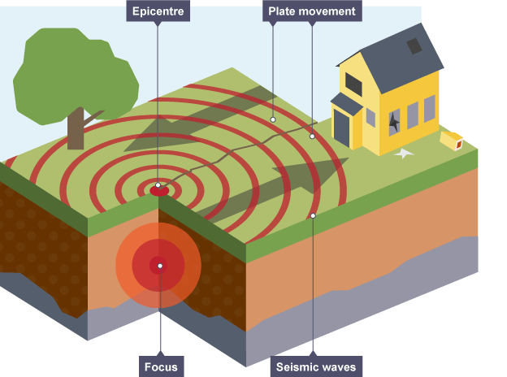
Title: How do we measure the impact of Earthquakes?
LO: Explain how earthquakes occur; Compare and contrast different measurement scales of seismic activity
Why do earthquakes happen?
Two plates at a plate margin are unable to move past each other easily, so they become locked. Pressure begins to build up.
Suddenly, the pressure is released and the plates quickly move into a new position. This releases energy as seismic waves. The shaking these waves cause on the Earth’s surface is what we call an earthquake.

Slide 5
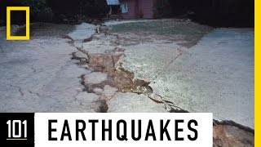
Title: How do we measure the impact of Earthquakes?
LO: Explain how earthquakes occur; Compare and contrast different measurement scales of seismic activity
Why do earthquakes happen?
What causes earthquakes to happen beneath the Earth’s surface?
Why are some earthquakes more destructive than others?
What are scientists and engineers doing to reduce the damage caused by earthquakes?
Tectonic plates move and grind against each other, releasing built-up pressure as shock waves.
They are stronger, shallower, or happen near cities where more people and buildings are affected.
Study data to predict future earthquakes and engineers design stronger buildings to reduce damage and keep people safe.
Notes:
https://www.youtube.com/watch?v=e7ho6z32yyo

Slide 6




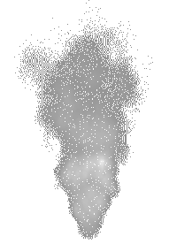
Title: How do we measure the impact of Earthquakes?
LO: Explain how earthquakes occur; Compare and contrast different measurement scales of seismic activity
Why do earthquakes happen?
Activity 1: Cut out and stick your diagram in your book. Use the diagram to explain how earthquakes happen.
Include these words in your description:
Plate movement 플레이트 이동 / 板式运动
Focus 초점 / 重点
Seismic Waves 지진파 / 地震波
Epicentre 진앙 / 震中
Why do shallow earthquakes (closer to the surface) cause more damage than deep earthquakes (further underground).
Why do you think some places experience more earthquakes than others?

Slide 7
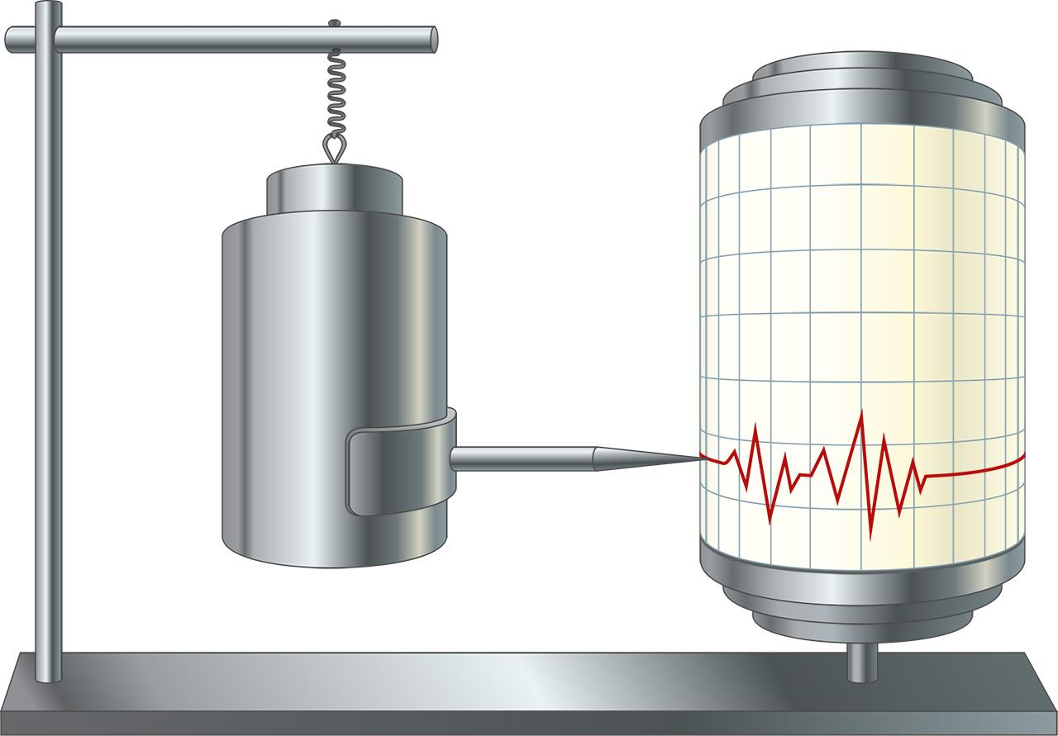
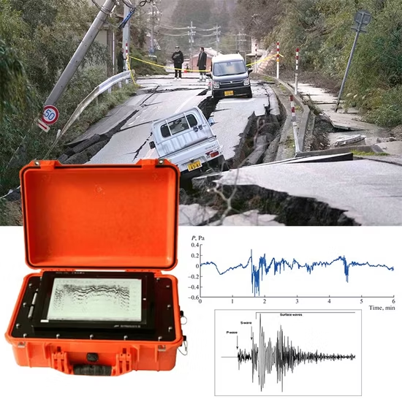
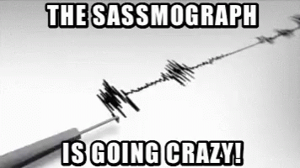
Title: How do we measure the impact of Earthquakes?
LO: Explain how earthquakes occur; Compare and contrast different measurement scales of seismic activity
Measuring Earthquakes
A seismometer is a scientific instrument that detects and records vibrations in the ground.
It works by measuring how much the ground shakes and turns that movement into data that scientists can use to determine the strength, duration and location of a seismic event.
This produces a seismogram which is the recording at the specific location.

Slide 8
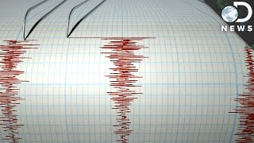
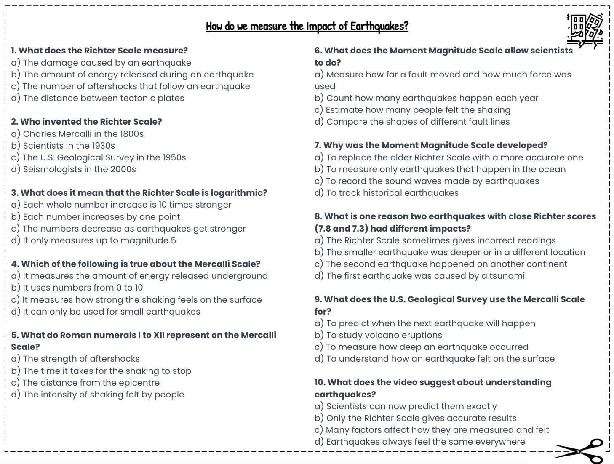
Title: How do we measure the impact of Earthquakes?
LO: Explain how earthquakes occur; Compare and contrast different measurement scales of seismic activity
Measuring Earthquakes
Activity 2: Complete the multiple choice questions whilst watching the video:
How Does The Richter Scale Work?
Notes:
https://www.youtube.com/watch?v=NaNw9LHq9dc

Slide 9
Title: How do we measure the impact of Earthquakes?
LO: Explain how earthquakes occur; Compare and contrast different measurement scales of seismic activity
Measuring Earthquakes
b) The amount of energy released during an earthquake
b) Scientists in the 1930s
a) Each whole number increase is 10 times stronger
c) It measures how strong the shaking feels on the surface
d) The intensity of shaking felt by people
a) Measure how far a fault moved and how much force was used
a) To replace the older Richter Scale with a more accurate one
b) The smaller earthquake was deeper or in a different location
d) To understand how an earthquake felt on the surface
c) Many factors affect how they are measured and felt
GREEN PEN YOUR ANSWERS

Slide 10
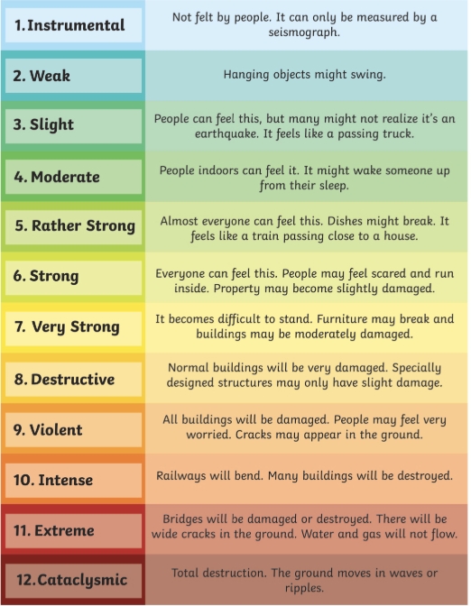
Title: How do we measure the impact of Earthquakes?
LO: Explain how earthquakes occur; Compare and contrast different measurement scales of seismic activity
Measuring Earthquakes - The Mercalli Scale
The Mercalli Scale is another way to measure earthquakes.
It uses Roman numerals from I (1) to XII (12).
Instead of measuring the energy of the earthquake, it shows how strong the shaking feels and how much damage it causes, based on people’s observations.

Slide 11
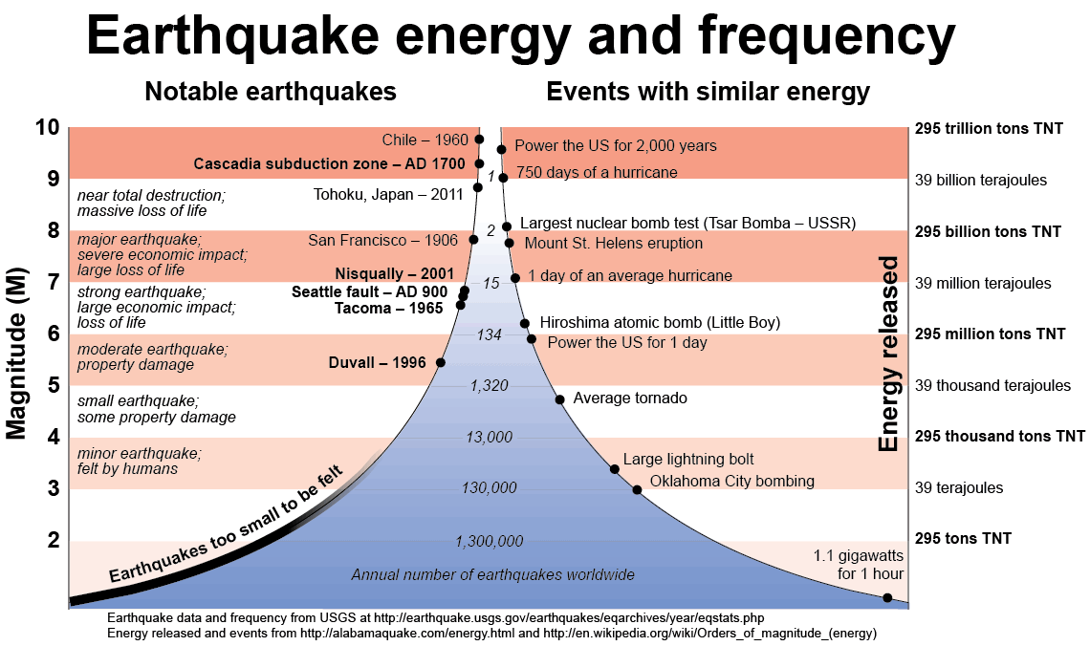
Title: How do we measure the impact of Earthquakes?
LO: Explain how earthquakes occur; Compare and contrast different measurement scales of seismic activity
Measuring Earthquakes - The Richter Scale
The Richter Scale is a way to measure the strength of an earthquake.
It uses numbers from 0 to 10 to show how much energy is released.
Each number on the scale means the earthquake is 10 times stronger than the one before it.
8 is when earthquakes are considered great
6 is when earthquakes are considered major
2 is the smallest quake normally felt by people
The higher the number, the stronger and more destructive the earthquake is. By using scientific methods, even very small earthquakes can be detected through seismic waves.

Slide 12
Title: How do we measure the impact of Earthquakes?
LO: Explain how earthquakes occur; Compare and contrast different measurement scales of seismic activity
Measuring Earthquakes
Activity 3:
Cut out and stick your diagram into your book.
Add the statements to either the Richter Scale or the Mercalli Scale.
Explain how the two scales measure earthquakes differently.
Uses Roman numerals from I to XII to show how strongly the earthquake was felt by people in different locations.
Can be used to compare earthquakes worldwide, regardless of where or how deep they occur.
Provides a subjective measurement based on people’s experiences and reports of damage.
Measures the magnitude of an earthquake based on the energy released at its source.
Provides a scientific measurement collected using seismographs and instruments.
Measures the intensity of shaking as experienced by people and observed on the surface.
Uses numerical values from 0 to 10 that increase logarithmically — each step represents a quake ten times stronger.
Can show how damage and shaking vary from place to place during the same earthquake.
Why do you think both scales are still used today, even though they measure different things?
Design a new earthquake scale. What would it measure, and how would it improve on the Richter and Mercalli Scales?
Notes:
https://www.youtube.com/watch?v=MexDriLX1gQ
https://www.youtube.com/watch?v=OHSJcYDaKlc

Slide 13
Title: How do we measure the impact of Earthquakes?
LO: Explain how earthquakes occur; Compare and contrast different measurement scales of seismic activity
Measuring Earthquakes - GREEN PEN YOUR ANSWERS
Mercalli Scale
Uses Roman numerals from I to XII to show how strongly the earthquake was felt by people in different locations.
Can be used to compare earthquakes worldwide, regardless of where or how deep they occur.
Provides a subjective measurement based on people’s experiences and reports of damage.
Measures the magnitude of an earthquake by calculating the energy released at its focus.
Gives a scientific measurement obtained from instruments called seismographs.
Measures the intensity of shaking as it is observed on the Earth’s surface.
Uses numbers from 0 to 10, where each step represents an earthquake ten times more powerful than the previous level.
Shows how shaking and damage can vary between areas during the same earthquake.
Richter Scale
Mercalli Scale
Richter Scale
Richter Scale
Mercalli Scale
Richter Scale
Mercalli Scale

Slide 14
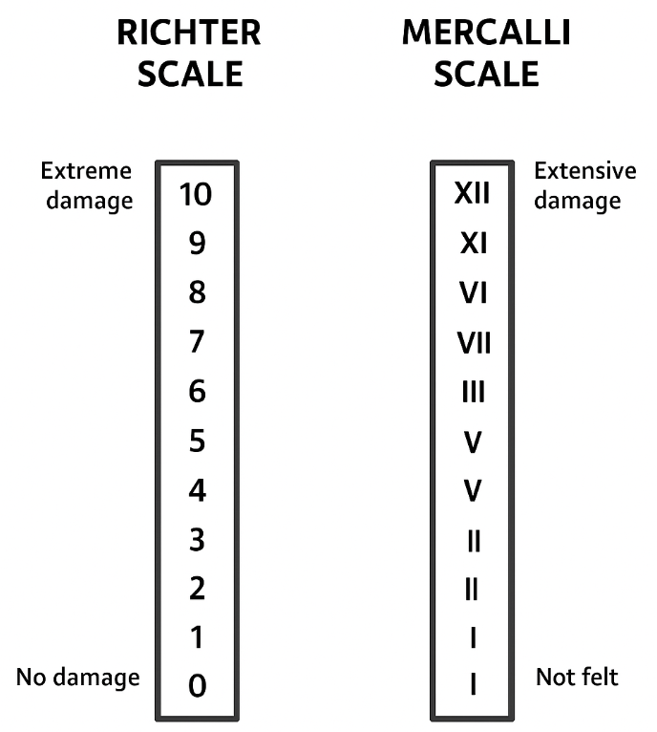
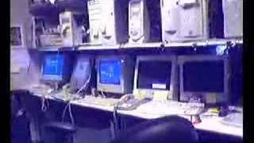

Title: How do we measure the impact of Earthquakes?
LO: Explain how earthquakes occur; Compare and contrast different measurement scales of seismic activity
Measuring Earthquakes - Rate the quake
Activity 4: For each video, guess the level on the Richter and Mercalli!
XII
XI
X
IX
VIII
VII
VI
V
IV
III
II
I
6.8
VIII
Tacoma, USA (2001)
Notes:
https://www.youtube.com/watch?v=c4mFh-I1Epc

Slide 15
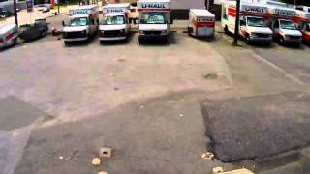
Title: How do we measure the impact of Earthquakes?
LO: Explain how earthquakes occur; Compare and contrast different measurement scales of seismic activity
Measuring Earthquakes - Rate the quake
Activity 4: For each video, guess the level on the Richter and Mercalli!
XII
XI
X
IX
VIII
VII
VI
V
IV
III
II
I
5.8
VI
Parkville Maryland, USA (2011)
Notes:
https://www.youtube.com/watch?v=pyC9b_W8sZA

Slide 16
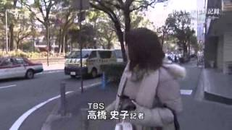
Title: How do we measure the impact of Earthquakes?
LO: Explain how earthquakes occur; Compare and contrast different measurement scales of seismic activity
Measuring Earthquakes - Rate the quake
Activity 4: For each video, guess the level on the Richter and Mercalli!
XII
XI
X
IX
VIII
VII
VI
V
IV
III
II
I
9
IX
Tōhoku earthquake, Japan (2011)
Notes:
https://www.youtube.com/watch?v=ij_iBRtBgsI

Slide 17

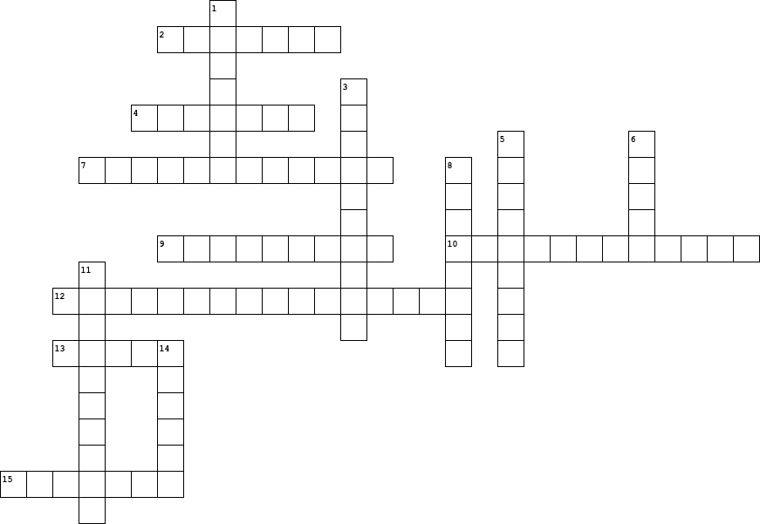
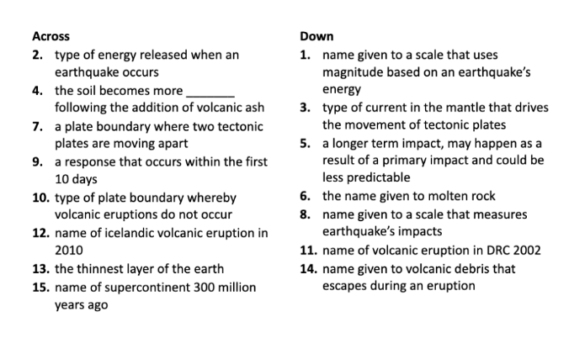
Title: How do we measure the impact of Earthquakes?
LO: Explain how earthquakes occur; Compare and contrast different measurement scales of seismic activity
Geog your memory!
Plenary: Tectonic Crossword!

Slide 18
Title: How do we measure the impact of Earthquakes?
LO: Explain how earthquakes occur; Compare and contrast different measurement scales of seismic activity
Green pen opportunity
Across
2. Seismic
4. Fertile
7. Constructive
9. Immediate
10. Conservative
12. Eyjafjallajökull
13. Crust
15. Pangaea
Down
1. Richter
3. Convection
5. Secondary
6. Magma
8. Mercalli
11. Nyiragongo
14. Tephra

